Slide 1
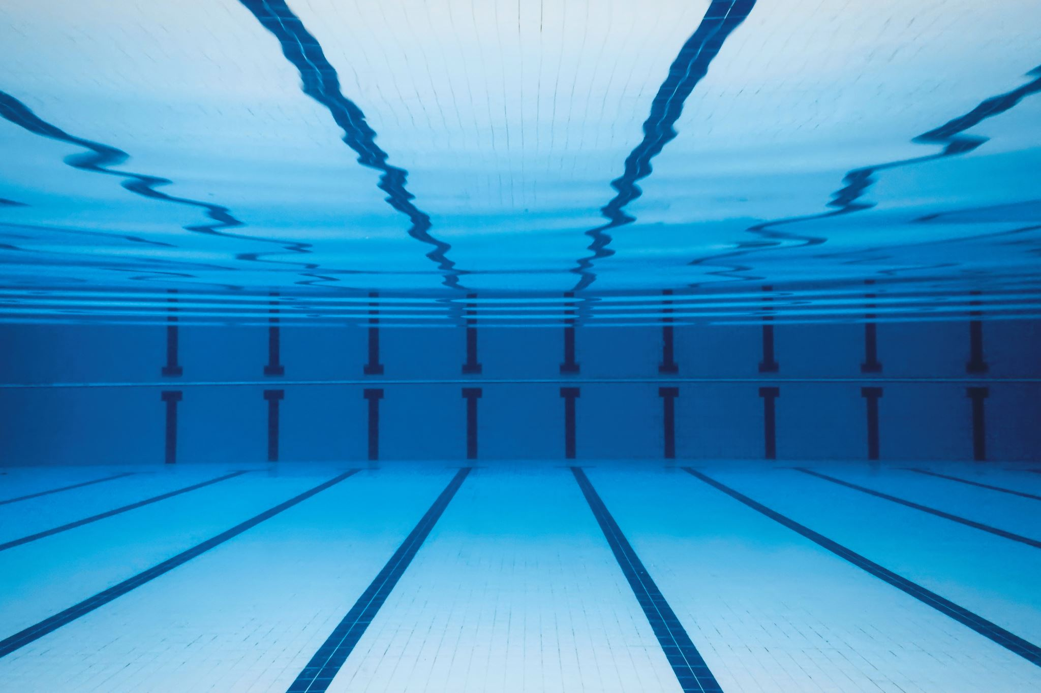
Corby Swimming Club
2020 AGM -30 July 2020

Slide 2
Agenda
Chairman’s Welcome/ President’s Address
Treasurer’s Report
Gala Report (a while ago now)
Coaches Report
Election of the club officers 2020/2021
Covid -19 return to training procedures
New Covid-19 Training Programme
Team Captains
A.O.B
Notes:
Chairman’s Welcome/ President’s Address
Constitution Changes
Treasurer’s Report
Gala Report (a while ago now)
Coaches Report
Counties
County Development Programme
Oliver Horne, Finley Dare, Aryan Nath, Samanta
Regional Times
Archie Olympic Trials
Election of the club officers 2020/2021
New Training Programme – Covid -19 return to training plan
Team Captain
A.O.B

Slide 3
Committee Members
Chairman – Chad O’Brien
Vice Chair – Andrew Cullen
Treasurer – Caroline Beaton
Secretary – Teresa Evans
Gala & Fixtures – Ken Pratt
Membership – Karen Blowfield
The Hub – Karen Armstrong
Disability Co-ordinator – Karen Armstrong
Swim 21 Co-ordinator/ Club Records – Roger Hey
Fundraising, Events & Marketing – Karen Bielby
Team Manager – Rob Preston
Welfare – Stacey Dando
Workforce – Teresa Evans
Trophy Steward – Andrew Cullen
Gala Co-ordinator – Kerry Stewart/ Katie Cotton
Covid-19 Lead -
Covid-19 Officers

Slide 4
Chairman’s Welcome

Slide 5
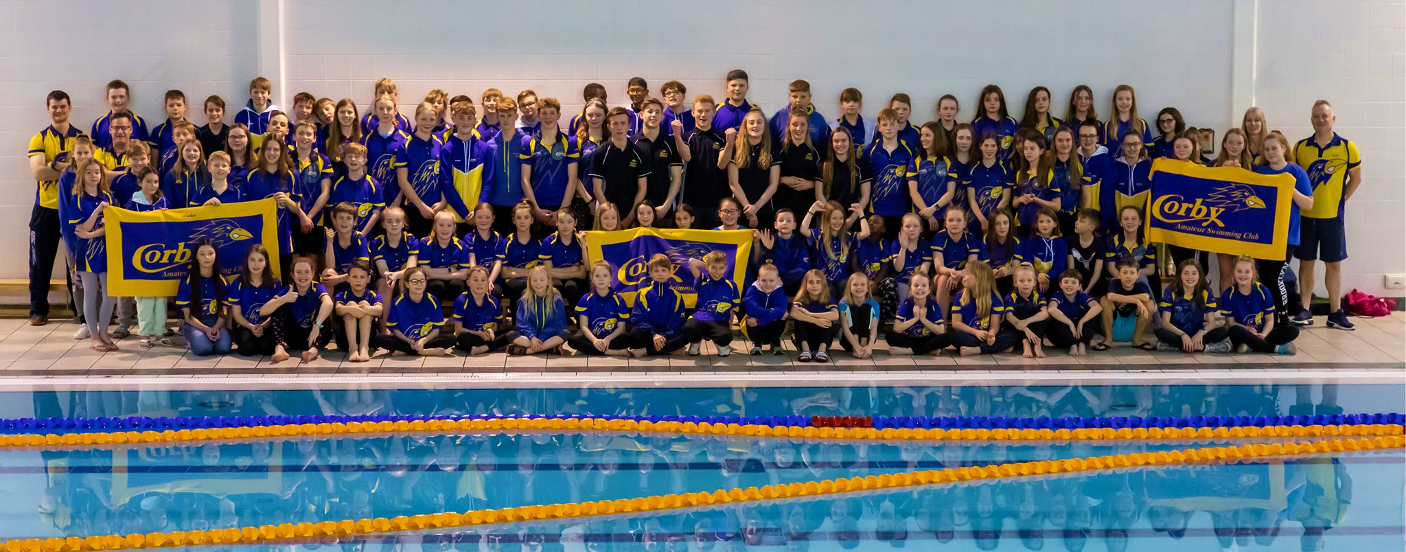
Chairman’s Welcome Message
A quote to lead us into this swimming year of 2020/2021 –
“BE GREAT. YOU NEVER KNOW WHO YOU`RE INSPIRING.”
Notes:
Good evening everyone. Welcome to CASC’s AGM for 2019/2020. How time has passed this year
with all its challenges and obstacles that we all have had to face whether it was individually or as a
group. It has been an amazing experience to work with a group of individuals at Corby who always
give of their best, and who have the swimmers best interest at heart at all times. Congratulations to
those swimmers who set out and have achieved their personal goals and to the swimming coaches
who dedicate themselves to the Corby Amateur Swimming Club. To my fellow committee members, I
would like to thank you for patience, honesty, commitment and your hard work behind the scenes to
ensure the future and success of Corby Amateur Swimming Club.
A quote to lead us into this swimming year of 2020/2021 – “BE GREAT. YOU NEVER KNOW WHO
YOU`RE INSPIRING.”

Slide 6
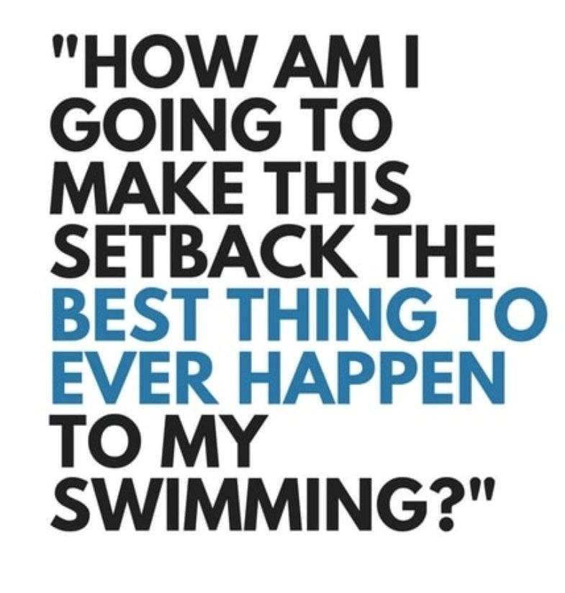
Chairman’s Welcome Message
Unfortunately, we will have to delay our return to the pool due to some maintenance issues with the 50m pool
We will send you an updated start date and timetable once we can confirm a date
Notes:
Good evening everyone. Welcome to CASC’s AGM for 2019/2020. How time has passed this year
with all its challenges and obstacles that we all have had to face whether it was individually or as a
group. It has been an amazing experience to work with a group of individuals at Corby who always
give of their best, and who have the swimmers best interest at heart at all times. Congratulations to
those swimmers who set out and have achieved their personal goals and to the swimming coaches
who dedicate themselves to the Corby Amateur Swimming Club. To my fellow committee members, I
would like to thank you for patience, honesty, commitment and your hard work behind the scenes to
ensure the future and success of Corby Amateur Swimming Club.
A quote to lead us into this swimming year of 2020/2021 – “BE GREAT. YOU NEVER KNOW WHO
YOU`RE INSPIRING.”

Slide 7
Chairman’s Welcome Message
Good evening everyone. Welcome to CASC’s AGM for 2019/2020. How time has passed this year with all its challenges and obstacles that we all have had to face whether it was individually or as a group. It has been an amazing experience to work with a group of individuals at Corby who always give of their best, and who have the swimmers best interest at heart at all times. Congratulations to those swimmers who set out and have achieved their personal goals and to the swimming coaches who dedicate themselves to the Corby Amateur Swimming Club. To my fellow committee members, I would like to thank you for patience, honesty, commitment and your hard work behind the scenes to ensure the future and success of Corby Amateur Swimming Club.
A quote to lead us into this swimming year of 2020/2021 – “BE GREAT. YOU NEVER KNOW WHO YOU`RE INSPIRING.”

Slide 8
President’s Address

Slide 9
President’s Welcome Message
The Coronavirus (Covid-19) Pandemic
Our Swimmers' Achievements over the past year
Our Open Meet
Some Tips for our Swimmers
The role of Swimmers' Parents
The running of the Club
Notes:
President's Address
The Coronavirus (Covid19) Pandemic
This has impacted massively on our club with no training or competitions since the middle of March.
However, we are looking to get up-and-running again on a limited basis from the 2nd August.
Loss of continuity and momentum is always detrimental but it has been the same for all swimming
clubs in the UK and around the world. Corby Amateur Swimming Club is planning to continue to be
very successful swimming club - the best it has ever been.
Our Swimmers' Achievements over the past year
These include another good performance in the Leicester Autumn League and many great
achievements in the County Championships before everything stopped.
Our Open Meet
Our Open Meet planned for Saturday 21st and Sunday 22nd March had to be cancelled on Monday
16th March as the seriousness of the pandemic became clear and it will not be possible to run our
October Open Meet either so it looks like the County Championships in January and February 2021
will be our next serious competition - if indeed those championships are able to take place.
Some Tips for our Swimmers
Firstly, as always, I urge all swimmers to train hard and often and to develop good fitness, good
technique and the will to win so that you all do the best you can at whatever level you swim at.
Secondly, I will just remind you all that because margins are so tight in major competitions - a few
hundredths of a second can sometimes make a big difference - you need to do the perfect start, the
perfect stroke, the perfect turn or turns and the perfect finish - i.e. the perfect swim. Easier said
than done, I know!
The role of Swimmers' Parents
It is not just the swimmers who are very important - so are the parents. We currently have 4
Referees, 5 Starters, 11 Judges Level Two, 9 Judges Level One and 8 Timekeepers, i.e. 37 Pool-side
Officials in all. I will be looking to upgrade as many of these people as possible and also find and
train some new Timekeepers and Judges Level One in the coming year.
The running of the Club
The work in running a swimming club is the equivalent of running a small-to medium-sized business
and I ask all swimmers and their parents to appreciate this and the parents to help in whatever way
they can. Running a swimming club is like life itself - a process of constant renewal.
Howard Wilkinson
President, Referee and Trainer of Pool-side Officials, Corby Amateur Swimming Club, 30th July 2020

Slide 10
President’s Welcome Message
The Coronavirus (Covid19) Pandemic
This has impacted massively on our club with no training or competitions since the middle of March.
However, we are looking to get up-and-running again on a limited basis from the 2nd August.
Loss of continuity and momentum is always detrimental but it has been the same for all swimming
clubs in the UK and around the world. Corby Amateur Swimming Club is planning to continue to be
very successful swimming club - the best it has ever been.
Our Swimmers' Achievements over the past year
These include another good performance in the Leicester Autumn League and many great
achievements in the County Championships before everything stopped.
Notes:
President's Address
The Coronavirus (Convid19) Pandemic
This has impacted massively on our club with no training or competitions since the middle of March.
However, we are looking to get up-and-running again on a limited basis from the 2nd August.
Loss of continuity and momentum is always detrimental but it has been the same for all swimming
clubs in the UK and around the world. Corby Amateur Swimming Club is planning to continue to be
very successful swimming club - the best it has ever been.
Our Swimmers' Achievements over the past year
These include another good performance in the Leicester Autumn League and many great
achievements in the County Championships before everything stopped.
Our Open Meet
Our Open Meet planned for Saturday 21st and Sunday 22nd March had to be cancelled on Monday
16th March as the seriousness of the pandemic became clear and it will not be possible to run our
October Open Meet either so it looks like the County Championships in January and February 2021
will be our next serious competition - if indeed those championships are able to take place.
Some Tips for our Swimmers
Firstly, as always, I urge all swimmers to train hard and often and to develop good fitness, good
technique and the will to win so that you all do the best you can at whatever level you swim at.
Secondly, I will just remind you all that because margins are so tight in major competitions - a few
hundredths of a second can sometimes make a big difference - you need to do the perfect start, the
perfect stroke, the perfect turn or turns and the perfect finish - i.e. the perfect swim. Easier said
than done, I know!
The role of Swimmers' Parents
It is not just the swimmers who are very important - so are the parents. We currently have 4
Referees, 5 Starters, 11 Judges Level Two, 9 Judges Level One and 8 Timekeepers, i.e. 37 Pool-side
Officials in all. I will be looking to upgrade as many of these people as possible and also find and
train some new Timekeepers and Judges Level One in the coming year.
The running of the Club
The work in running a swimming club is the equivalent of running a small-to medium-sized business
and I ask all swimmers and their parents to appreciate this and the parents to help in whatever way
they can. Running a swimming club is like life itself - a process of constant renewal.
Howard Wilkinson
President, Referee and Trainer of Pool-side Officials, Corby Amateur Swimming Club, 30th July 2020

Slide 11
President’s Welcome Message
Our Open Meet
Our Open Meet planned for Saturday 21st and Sunday 22nd March had to be cancelled on Monday
16th March as the seriousness of the pandemic became clear and it will not be possible to run our
October Open Meet either so it looks like the County Championships in January and February 2021
will be our next serious competition - if indeed those championships are able to take place.
Some Tips for our Swimmers
Firstly, as always, I urge all swimmers to train hard and often and to develop good fitness, good
technique and the will to win so that you all do the best you can at whatever level you swim at.
Secondly, I will just remind you all that because margins are so tight in major competitions - a few
hundredths of a second can sometimes make a big difference - you need to do the perfect start, the
perfect stroke, the perfect turn or turns and the perfect finish - i.e. the perfect swim. Easier said
than done, I know!
Notes:
President's Address
The Coronavirus (Convid19) Pandemic
This has impacted massively on our club with no training or competitions since the middle of March.
However, we are looking to get up-and-running again on a limited basis from the 2nd August.
Loss of continuity and momentum is always detrimental but it has been the same for all swimming
clubs in the UK and around the world. Corby Amateur Swimming Club is planning to continue to be
very successful swimming club - the best it has ever been.
Our Swimmers' Achievements over the past year
These include another good performance in the Leicester Autumn League and many great
achievements in the County Championships before everything stopped.
Our Open Meet
Our Open Meet planned for Saturday 21st and Sunday 22nd March had to be cancelled on Monday
16th March as the seriousness of the pandemic became clear and it will not be possible to run our
October Open Meet either so it looks like the County Championships in January and February 2021
will be our next serious competition - if indeed those championships are able to take place.
Some Tips for our Swimmers
Firstly, as always, I urge all swimmers to train hard and often and to develop good fitness, good
technique and the will to win so that you all do the best you can at whatever level you swim at.
Secondly, I will just remind you all that because margins are so tight in major competitions - a few
hundredths of a second can sometimes make a big difference - you need to do the perfect start, the
perfect stroke, the perfect turn or turns and the perfect finish - i.e. the perfect swim. Easier said
than done, I know!
The role of Swimmers' Parents
It is not just the swimmers who are very important - so are the parents. We currently have 4
Referees, 5 Starters, 11 Judges Level Two, 9 Judges Level One and 8 Timekeepers, i.e. 37 Pool-side
Officials in all. I will be looking to upgrade as many of these people as possible and also find and
train some new Timekeepers and Judges Level One in the coming year.
The running of the Club
The work in running a swimming club is the equivalent of running a small-to medium-sized business
and I ask all swimmers and their parents to appreciate this and the parents to help in whatever way
they can. Running a swimming club is like life itself - a process of constant renewal.
Howard Wilkinson
President, Referee and Trainer of Pool-side Officials, Corby Amateur Swimming Club, 30th July 2020

Slide 12
President’s Welcome Message
The role of Swimmers' Parents
It is not just the swimmers who are very important - so are the parents. We currently have 4
Referees, 5 Starters, 11 Judges Level Two, 9 Judges Level One and 8 Timekeepers, i.e. 37 Pool-side
Officials in all. I will be looking to upgrade as many of these people as possible and also find and
train some new Timekeepers and Judges Level One in the coming year.
The running of the Club
The work in running a swimming club is the equivalent of running a small-to medium-sized business
and I ask all swimmers and their parents to appreciate this and the parents to help in whatever way
they can. Running a swimming club is like life itself - a process of constant renewal.
Howard Wilkinson
President, Referee and Trainer of Pool-side Officials, Corby Amateur Swimming Club, 30th July 2020
Notes:
President's Address
The Coronavirus (Convid19) Pandemic
This has impacted massively on our club with no training or competitions since the middle of March.
However, we are looking to get up-and-running again on a limited basis from the 2nd August.
Loss of continuity and momentum is always detrimental but it has been the same for all swimming
clubs in the UK and around the world. Corby Amateur Swimming Club is planning to continue to be
very successful swimming club - the best it has ever been.
Our Swimmers' Achievements over the past year
These include another good performance in the Leicester Autumn League and many great
achievements in the County Championships before everything stopped.
Our Open Meet
Our Open Meet planned for Saturday 21st and Sunday 22nd March had to be cancelled on Monday
16th March as the seriousness of the pandemic became clear and it will not be possible to run our
October Open Meet either so it looks like the County Championships in January and February 2021
will be our next serious competition - if indeed those championships are able to take place.
Some Tips for our Swimmers
Firstly, as always, I urge all swimmers to train hard and often and to develop good fitness, good
technique and the will to win so that you all do the best you can at whatever level you swim at.
Secondly, I will just remind you all that because margins are so tight in major competitions - a few
hundredths of a second can sometimes make a big difference - you need to do the perfect start, the
perfect stroke, the perfect turn or turns and the perfect finish - i.e. the perfect swim. Easier said
than done, I know!
The role of Swimmers' Parents
It is not just the swimmers who are very important - so are the parents. We currently have 4
Referees, 5 Starters, 11 Judges Level Two, 9 Judges Level One and 8 Timekeepers, i.e. 37 Pool-side
Officials in all. I will be looking to upgrade as many of these people as possible and also find and
train some new Timekeepers and Judges Level One in the coming year.
The running of the Club
The work in running a swimming club is the equivalent of running a small-to medium-sized business
and I ask all swimmers and their parents to appreciate this and the parents to help in whatever way
they can. Running a swimming club is like life itself - a process of constant renewal.
Howard Wilkinson
President, Referee and Trainer of Pool-side Officials, Corby Amateur Swimming Club, 30th July 2020

Slide 13
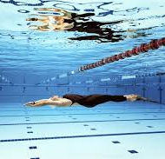
Notes:
President's Address
The Coronavirus (Convid19) Pandemic
This has impacted massively on our club with no training or competitions since the middle of March.
However, we are looking to get up-and-running again on a limited basis from the 2nd August.
Loss of continuity and momentum is always detrimental but it has been the same for all swimming
clubs in the UK and around the world. Corby Amateur Swimming Club is planning to continue to be
very successful swimming club - the best it has ever been.
Our Swimmers' Achievements over the past year
These include another good performance in the Leicester Autumn League and many great
achievements in the County Championships before everything stopped.
Our Open Meet
Our Open Meet planned for Saturday 21st and Sunday 22nd March had to be cancelled on Monday
16th March as the seriousness of the pandemic became clear and it will not be possible to run our
October Open Meet either so it looks like the County Championships in January and February 2021
will be our next serious competition - if indeed those championships are able to take place.
Some Tips for our Swimmers
Firstly, as always, I urge all swimmers to train hard and often and to develop good fitness, good
technique and the will to win so that you all do the best you can at whatever level you swim at.
Secondly, I will just remind you all that because margins are so tight in major competitions - a few
hundredths of a second can sometimes make a big difference - you need to do the perfect start, the
perfect stroke, the perfect turn or turns and the perfect finish - i.e. the perfect swim. Easier said
than done, I know!
The role of Swimmers' Parents
It is not just the swimmers who are very important - so are the parents. We currently have 4
Referees, 5 Starters, 11 Judges Level Two, 9 Judges Level One and 8 Timekeepers, i.e. 37 Pool-side
Officials in all. I will be looking to upgrade as many of these people as possible and also find and
train some new Timekeepers and Judges Level One in the coming year.
The running of the Club
The work in running a swimming club is the equivalent of running a small-to medium-sized business
and I ask all swimmers and their parents to appreciate this and the parents to help in whatever way
they can. Running a swimming club is like life itself - a process of constant renewal.
Howard Wilkinson
President, Referee and Trainer of Pool-side Officials, Corby Amateur Swimming Club, 30th July 2020

Slide 14
Treasurer’s Report

Slide 15
Treasurer’s Report for Corby Amateur Swimming Club AGM
CASC’s year end is 30th September and therefore this report focuses only on the results for the year ended 30th September 2019. The club continues to enjoy sound financial performance. (Covid-19 will effect next years accounts accordingly)
After a strong 2018 driven by significant increases in membership, 2019 has seen a continuation of this positive trend with membership increases offsetting a small downside in gala revenue. Overall revenue increased by £14,681. However, there have been significant increases in pool hire costs to cope with the expansion of the club. We now use both Corby and Uppingham for training and have incurred above inflation increases in hire rates. Coaching costs have also increased in line with increased pool time. The club paid it’s corporation tax due at £3,917. As such, overall expenses have increased by £28,568 and the club retained a small surplus of £4,353.
The club has maintained its cash reserves and retains sufficient cash to continue as a going concern for the foreseeable future.
The club has invested over £5,700 in new equipment in the year including a new sign for our home pool. The club has also continued to invest in coaching and will continue to do so in the future.

Slide 16
GALA & FIXTURES Report

Slide 17
Up to 23rd March
Very different season to previous years and here we are with On-line Meetings and AGM
Competed in the normal Open meets, Regionals, Nationals, league galas, Club Championships along with County galas and championships although restricted
Ran only 8 galas this season along with assisting at the County Championships and the County Short Course
Club Championships / Development Galas
Continued to hold joint events with Nene Valley swimming club - This helps both clubs as resources can be pooled and also helps reduce gala entry fees as we can now fill an entire Saturday night session.
Club Championships for 100m 200/400m and 800/1500m held in the last quarter of 2019. No 50m championships
Two Development galas held – Round 2 was the last event before the lockdown. Certificates for swimmers still to be issued. These will be done as we get back to training
CASC October Open Meet
Our 1 Day long course event on October 5th. This was our fifth 1 day open meet consisting of 50m, 100m & 200IM events
Another successful meet with many clubs enquiring about the next one

Slide 18
Up to 23rd March – Cont’d
League galas
Planned to enter two leagues during this season, the Leicester Autumn League & the Leicester Diddy League
Only the Autumn league ran and we competed in the final finishing third on the night and third in the league overall out of 27 teams. Beaten by Nuneaton in first place and Rushden in second place
In 2018 we finished in second place
County Galas / Championships
Four county galas held per year. Short Course, Wilkinson Sword, Sadie Murray & Presentation gala
Only the short course was held back in September 2019 in Rugby. Corby competed very successfully at this event
County Championships were held over 4 weekends in January & February. These were some of the swimmers last competition before the lockdown

Slide 19
CASC MARCH OPEN MEET
March LC Event
Planned to run 2 Open meets during the season
This would have been our third 2 day March meet consisting of all strokes and distances except 800/1500m & the 100IM
Cancelled 5 days before the event as advised by Swim England and the Government guidelines
Meet continued to be very popular and was well oversubscribed with many rejections
Following cancellation, the following weeks were taken up unravelling it all and issuing refunds
The only loses were swimmers not competing for new times and medals and the income generated from the open meets. All bookings refunded back to the club and remaining items already purchased can be used for future open meets

Slide 20
FUTURE GALAS
Swim England are currently not licensing meets and have recalled licenses previously issued
The galas in the Corby calendar for the new season up to December 2020 will not go ahead. The pool has been booked for extra training on Saturday to ensure as much pool time can be given to getting swimmers back to their previous form
The galas were to be the Club Championships, (100m, 200/400m), the Development gala Rd1 (Not licensed) and October Open meet
The Leicester Autumn League will not be run
Unsure at present what format 2021 season will take. This will be worked on over the coming weeks/months to put a fixture list together. We are expecting County Championships to possibly be the first events. Rules and entry timings will need to be amended to take account of no competitive swimming for nearly 12 months

Slide 21
VOLUNTEER OVERVIEW
As in running a swimming club takes considerable time and effort, so does sorting out entries and running swimming galas. Chantel & I have been doing this for many years now with Chantel concentrating more on the Open meets/Regionals and I on the Club Championships and League galas
Sally has been doing the Gala Coordinators role for a couple of years now. This coming season she is stepping down. I would like to Thank Sally for her fantastic help in recruiting volunteers and organising them for all the galas we put on during this time. This is not an easy job to get people to help out on poolside
We have two potential people to fill this role Kerry Stewart & Katie Cotton. It is currently proposed to split the role into two with one concentrating on Open Meets & Club championships and the other on League galas, Development galas and NASA events.
As always, we still welcome more help to share the work. So if anyone is interested in helping the club then please contact a member of the committee. Help is always needed, as swimmers and parents move on and leave gaps for others to fill.

Slide 22
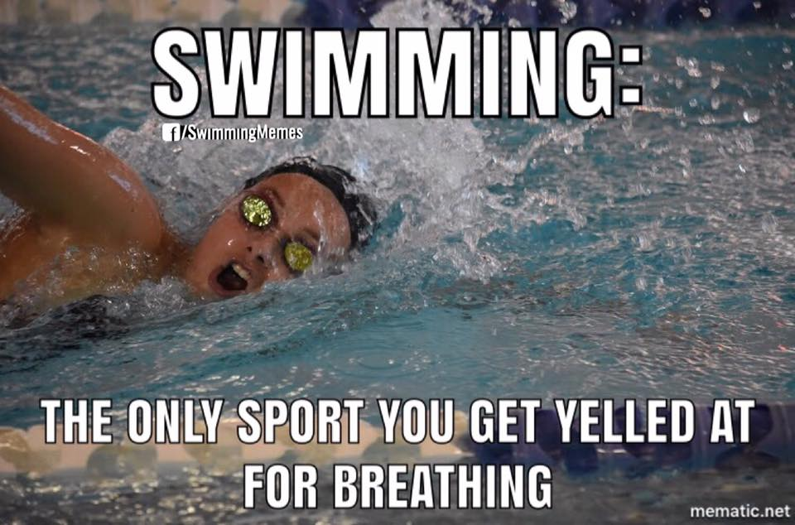
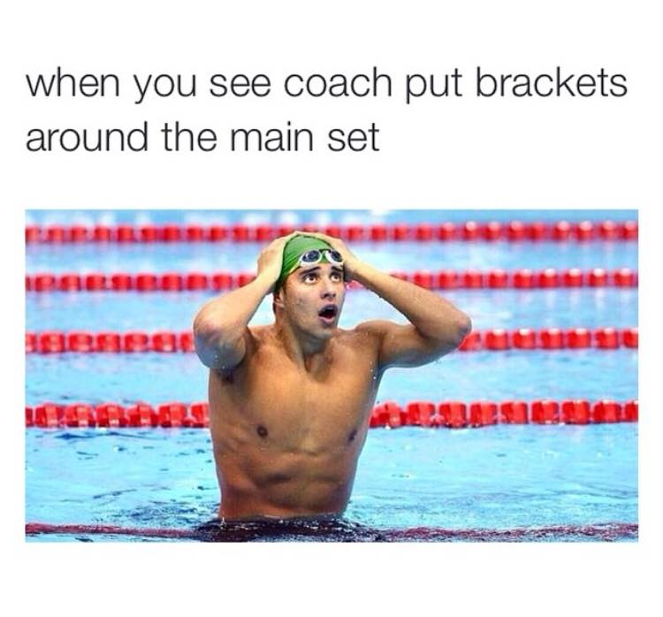

Slide 23
FINAL THANK YOUS
Finally Corby’s success does not happen on its own. It takes team work with all the volunteers working on the committee, the volunteer helpers, swimmers and coaches to make a club of this size run including the constant training of officials to keep on top of the ones moving on. I would like to thank all the people that helped at the gala events put on last season. As I keep saying without your help we could not put these events on. I hope that you all had a relaxing unexpected break and looking forward to swimming again, as it will be possibly be Kerry, Katie or Howard contacting you in the coming weeks maybe months to kick the season off again.
Enjoy 2020/2021 swimming season
Ken Pratt
G & F Secretary

Slide 24
Head Coach Report
Notes:
128 days since we were forced to close, we wish to welcome you back

Slide 25
Head Coaches Report
For many reasons 2020 has been a very strange year but for me personally (and I suspect for most of the Corby swimmers) it’s been really frustrating, mainly because I honestly believe that it would have been our most successful ever and we’ll never know if I would have been right!
The club has really gone from strength to strength in all ways with increasing membership, an expanding number of committed coaches and a rock solid army of willing volunteers and helpers who always go that extra mile to ensure our swimmers get what they need to succeed and have fun.
The County Championships did take place in January and we had our most successful competition in memory with huge P.B’s and lots of finalists and medals won; Our diddy team was ready to go and my prediction would have been a top three finish for the team; Four of our up and coming younger swimmers Samanta Legacinskiene, Aryan Nath, Oliver Horne and Finley Dare swimmers, were all selected as part of the County Talent Pathway to train with other County performance swimmers but unfortunately didn’t get to show their skills;

Slide 26
Head Coaches Report
Our March Open Meet was setup and once again brilliantly organised ready to put down another marker as Corby being the top club in the country to organise and host a meet, only for us to see it cancelled with days to go; Our club Championships didn’t get to go ahead; Our elite swimmers had all worked incredibly hard to gain Regional qualification and many would have gone to the championships ranked in finalist places. I predict we would have won a record number of medals having witnessed the amazing work they were completing; We even had Archie Evans and Louis Mitchell qualified and ready to rub shoulders with the next Olympians in London at the GB Olympic trials in July! I again predict we would have seen amazing achievements by both but again that blinking virus threw a curve ball and even the Olympics were postponed!
The great thing, even with all the chaos we have endured during 2020 though, is that none of the above opportunities have gone away, they have simply been delayed. The coaching team and I are all completely focused and excited to now get back in the water and hopefully 2021 will see our lives return to more normality. We all are really looking forward to seeing the above predictions come to fruition alongside the next generation of superstars come through at Corby.
See you all soon
Tim and the coaches at Corby
July 2020

Slide 27
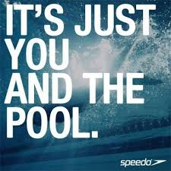
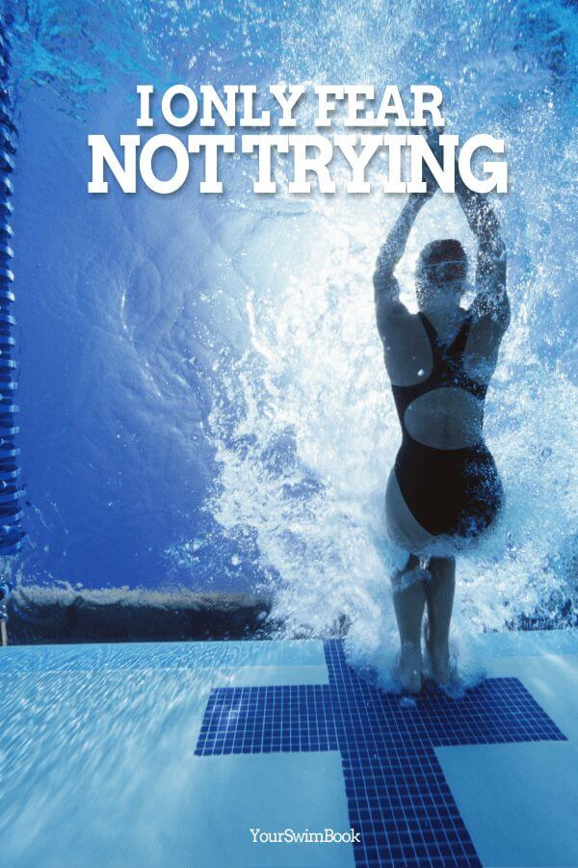

Slide 28
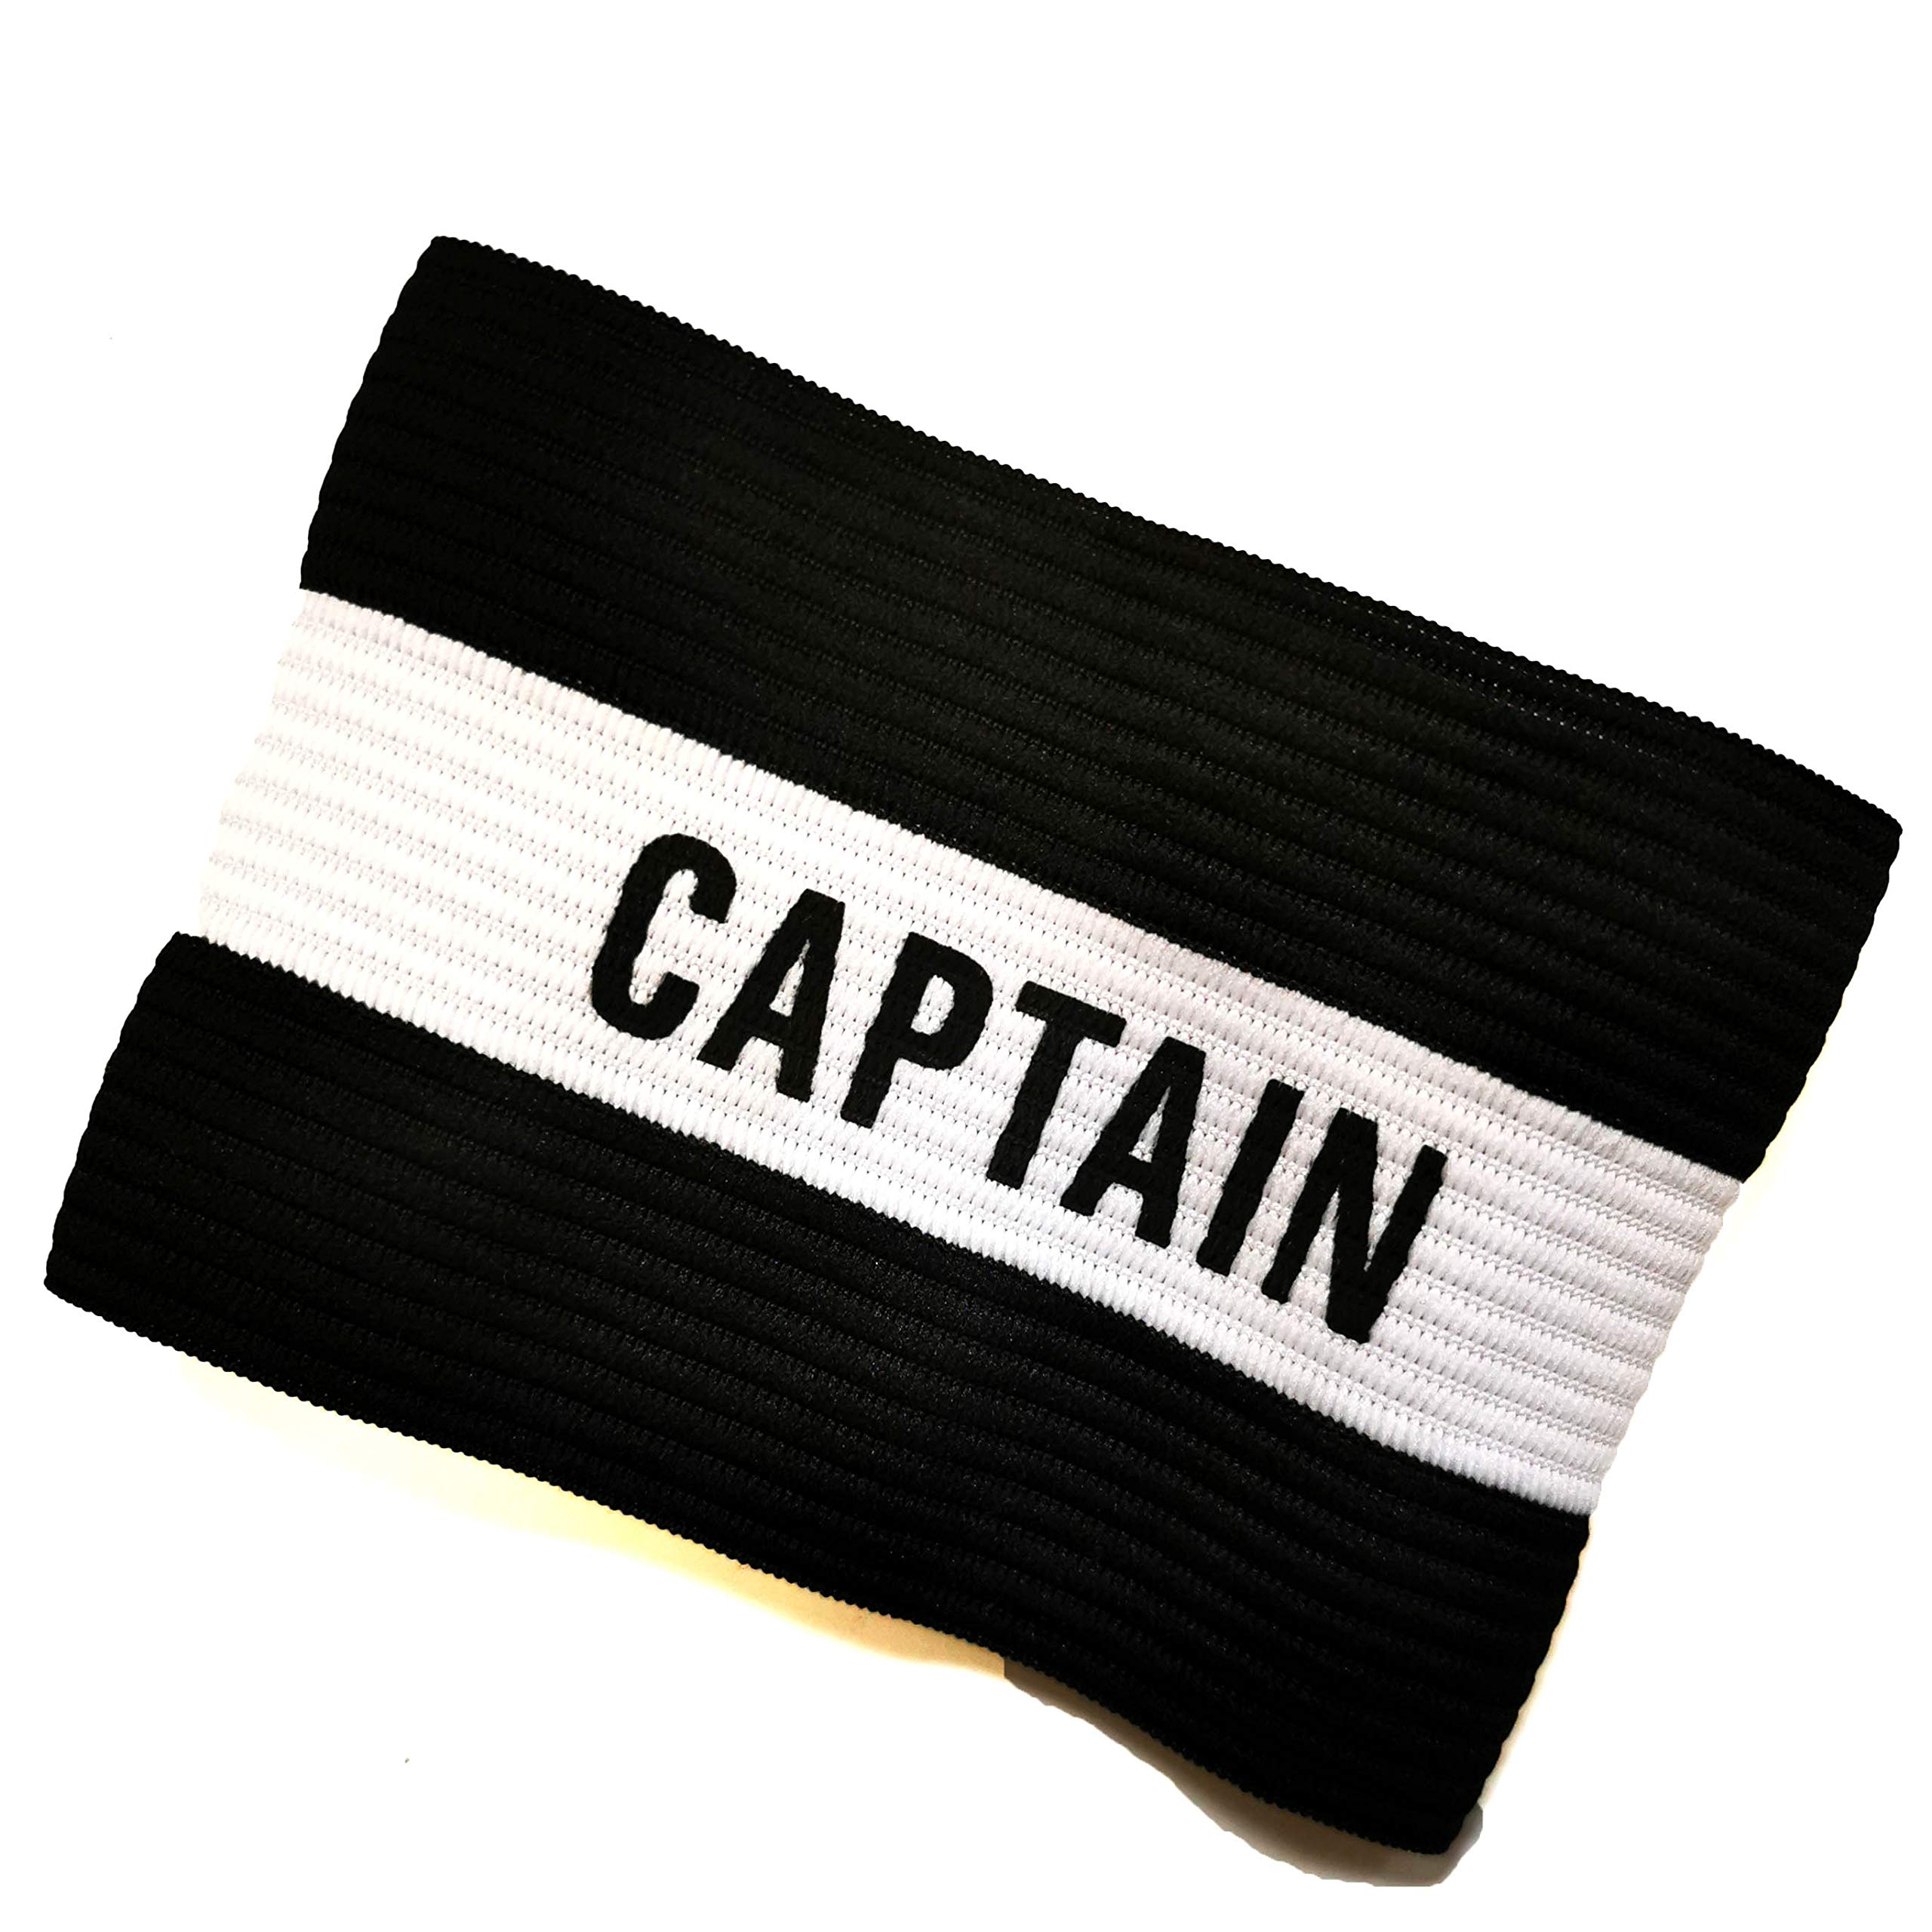
Club Captains
Senior : Archie Evans (Olympic Trials Qualifier)
Junior : Aryan Nath (Regional Qualifier 1st time)

Slide 29
Coaching Plan
We rolled out a more sophisticated training plan based around the club awards system for our academy squads.
We will continue to use this frame work to provide the best coaching to our swimmers
We rolled out more parents meetings to every squad.
Time for parents to ask questions and understand the sport better
A clearer understanding of progression through out the squads
Clearer communication from the coaching team
We are working on streamlining our competition plans for the club
Maximising the SC part of the season
We had planned to make our Level 3 meet in October to me SC
This may take more time of course with the disruption
2 tier approach to competitions with the bulk of our swimmers using Level 3 meets.
Our top swimmers need more exposure to Level 1 competitions.

Slide 31
Election of the club officers 2020/2021
Notes:
128 days since we were forced to close, we wish to welcome you back

Slide 32
Committee Members
Chairman – Chad O’Brien
Vice Chair – Andrew Cullen
Treasurer – Caroline Beaton
Secretary – Teresa Evans
Gala & Fixtures – Ken Pratt/Chantel O’Brien
Membership – Karen Blowfield
The Hub – Karen Armstrong
Disability Co-ordinator – Karen Armstrong
Swim 21 Co-ordinator/ Club Records – Roger Hey
Fundraising, Events & Marketing – Karen Bielby
Team Manager – Rob Preston
Welfare – Stacey Dando
Workforce – Teresa Evans
Trophy Steward – Andrew Cullen
Gala Co-ordinator – Kerry Stewart/ Katie Cotton
Covid-19 Lead – Karen Blowfield
Covid-19 Officers
Teresa Evans
Karen Bielby
Karen Armstrong
Helen Cullen
Andrew Cullen

Slide 33
Return to training Survey

Slide 34
Will you be returning to the club once swimming pools reopen?

Slide 35
Return to training Plan

Slide 36
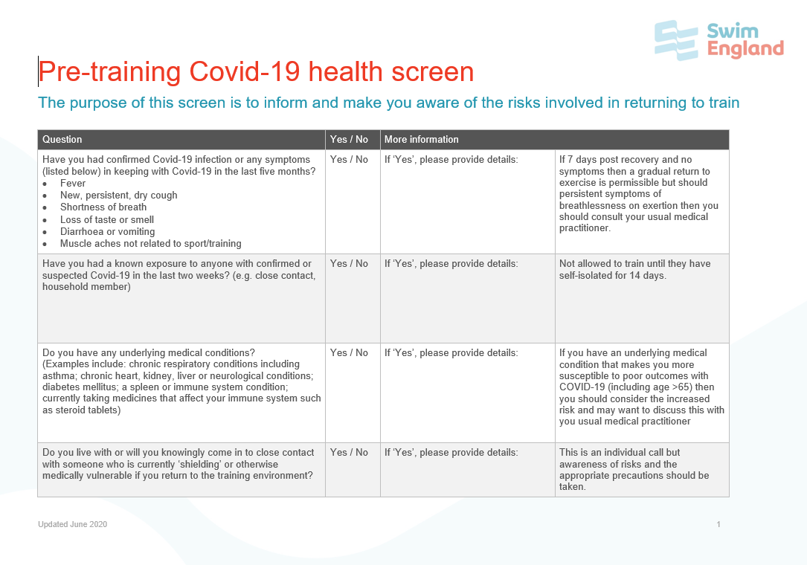
How to get back into the pool?
Have you been on Club organiser?
You MUST read these before the first session
This will be captured in one tick box on Club organiser. (You do not need to print this anymore)

Slide 37
How to get back into the pool?
Lanes will have reduced numbers (following Swim England's guidelines)
Single width lanes for club swimming (this allows for more flexibility when coaching, less swimmers being stuck behind others)
Max 6 people in a 25m lane
Max 4 people in a 20m lane
Max 12 people in a 50m lane
We will endeavour to run training with less people in the lane
We currently have access to 6 lanes in the 25m pool and we have spaced out the programme to allow more space for each swimmer
Please come beach ready! (Change on the poolside!)
That means if you need help to put your hat on, please do it before you arrive
Please make use of the hand sanitizers on entrance to the pool! It is really important that everyone uses these

Slide 39
On Exit of the pool?
No showers are available for the swimmers
Please shower at home
The club has been allocated some change rooms to allow for FAST changing
Individual changing rooms only!
Please listen to and follow the instructions given to you by the COVID Officers
Please make use of the hand sanitizers on exit to the pool! It is really important that everyone uses these

Slide 40
How to get back into the pool? (25m)
Flags
Flags
2
3
4
5
6
1
2
3
4
5
6
1
2
3
4
5
6
1
2
3
4
5
6
1
2
3
4
5
6
1
2
3
4
5
6
1

Slide 41
How to get back into the pool? (20m)
Flags
Flags
2
3
4
1
2
3
4
1
2
3
4
1
2
3
4
1

Slide 42
How to get back into the pool? (50m)
Flags
Flags
2
3
4
5
6
7
8
9
10
11
12
1
2
3
4
5
6
7
8
9
10
11
12
1
2
3
4
5
6
7
8
9
10
11
12
1
2
3
4
5
6
7
8
9
10
11
12
1
2
3
4
5
6
7
8
9
10
11
12
1

Slide 43
Training Plan

Slide 44
How to get back into the pool?
Each swimmer is responsible for keeping a safe distance from each other.
2m on the pool deck please
The coaching staff will do there best to remind swimmers about social distancing
If swimmers are seen to increasing the risk to the other swimmers they will be asked to leave the training session
Phased return of the club back into training
This is to give us as the coaching staff and the pool confidence that the procedures we are talking about now can be implemented correctly
Training will return with low intensity, technical skills for the majority of the time.
It is crucial we take this time to focus on this skills, make our selves better technically before we challenge ourselves physically.
We will eventually plan to hold some club champ style competitions when we feel it is possible to do so safely.

Slide 45
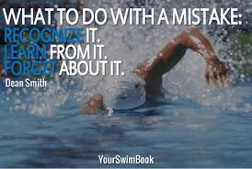
How to get back into the pool?

Slide 46
Questions

Slide 47
Questions
Where are parents to wait/can they go still watch on the balcony?
No parents are allowed into the building, the balcony is closed to all parents.
Will they be allowed into the changing rooms?
Parents will not be allowed into the changing rooms, please make sure the swimmers come ready for training and are as self sufficient as possible.
The pool and club are currently working on an agreement to manage the changing rooms as we previously took no responsibility of swimming in the changing area.
Is Academy Plus considered as a junior squad for training on a Saturday if it does go ahead?
The plan is to give Academy + another session. Whether it is in the 50m pool or the 20m pool is currently undecided
Will the Covid-19 forms be available to print or can I copy and write out what is on the form on paper?
Now on Club Organiser

Slide 48
Questions
Social distancing in and out of the pool and hygiene in the changing rooms?
This is will managed through the use of the 2m boxes on the side of the pool. The pool are adding extra staff to keep cleaning the facilities.
_____ is worried about being close to other people incase she gets coronavirus
Keeping apart will need to be the swimmers responsibility, in and out of the water
Also getting up to previous fitness levels and ensuring she doesn’t feel frustrated or under pressure to be back where she was immediately.
The coaching team completely understand that swimmers have been out of the water for over 130 days! And along side the reduced programme swimmers should feel comfortable returning
We need to understand more about the arrangements for the changing rooms and whether we can still stay in the pool, whilst the lessons are on.
With swimmers coming “beach ready” changing rooms should only be used to leave and only if necessary.

Slide 49
Questions
Social distancing during briefings and when in pool between sets.
Swimmers will be allocated a place where they will stop after reps. They will then stay in these positions during any briefings.
Make sure anyone has been tested for temperature before entering the pool to minimise any chance for the others to catch...
The currently risk assessment and pool operating procedure doesn’t require temperature testing
I feel that there are always large crowds at the beginning and end of swimming training sessions and would like to see this managed, perhaps staggered start times, different entrances/exits etc.
This is currently a work in progress, we might be able to stagger 2 squads finish times, however you would still have 24 swimmers from the main pool descending on the changing rooms, hence why we request that swimmers don’t use the changing rooms unless they need too.
How will the club maintain social distancing guidelines with so many swimmer?
Simple we will spread the swimmers out into more lanes (6 instead of 4), the younger squads have been split into 2 groups
Most of the questions parents will have, have been answered by the clubs risk assessment.

Slide 50
What are you most looking forward too?

Slide 51
Any Questions?

